Slide 1


Matt cust
09 July 2024

Slide 2

Outline
Executive Summary
Introduction
Methodology
Results
Conclusion
Appendix

Slide 3

Executive Summary
Summary of methodologies
All methodologies used can be found within the scripts stored in this git hub project: https://github.com/Matt-Cust/IBM-DS0720EN-Capstone-project
Summary of all results
I know, a bad joke but I couldn’t help it. I have to apologise, I am required to write reports often in y current job and have decided to have some fun with this one.
Section | Marks | Possible
Graded Quiz: Web Scraping | 3 | 4
Graded Quiz: Data Wrangling | 3 | 4
Graded Quiz: Exploratory Analysis using SQL | 5 | 5
Graded Quiz: Complete the EDA with Visualization | 3 | 3
Graded Quiz: Interactive Visual Analytics and Dashboard | 10 | 10
Graded Quiz: Predictive Analysis | 3 | 3
Peer Review: Submit your Work and Review your Peers | TBD | 40

Slide 4
Executive Summary
Summary of methodologies
All methodologies used can be found within the scripts stored in this git hub project: https://github.com/Matt-Cust/IBM-DS0720EN-Capstone-project
Summary of all results
In summary several ML methods were attempted with varying parameters, these were all compared and the highest accuracy was somewhere in the 75-85% success at predicting safe landing of the stage 1 booster, not a bad level of accuracy but not enough for me to bet on.
I also think that location played a part something to do with payload mass, and overall they became better at safe landings as time went on.

Slide 5
Introduction
Project background and context
In an effort to demonstrate and test upon all DS skills acquired throughout the course a final capstone project was performed. In this project data from SpaceX was provided, it was then cleaned via python and analysed with the primary goal of determining if it would be possible to correctly predict the safe landing of stage 1 boosters based upon other launch information.
Problems you want to find answers
In this project I wanted to determine if I would be able to recall and employ my learnings from over the past few months regarding data science in python.

Slide 6

Section 1

Slide 7
Methodology
Executive Summary
Data collection methodology:
.get from requests was used to get the data from the spaceX APIs - https://api.spacexdata.com/v4/rockets/ / https://api.spacexdata.com/v4/cores/ although in reality I just used the existing script to read_csv from the provided URL
There was also a section on web scraping where a series of table were extracted from Wikipedia where Beautiful soup was used to gather the information, and pre-fab functions used to coalesce the data into usable formats.
Perform data wrangling
Missing data was identified and either the rows removed or missing data replaced with he column average, and abhorrent data type columns were shifted to a preferred data type.
Perform exploratory data analysis (EDA) using visualization and SQL

Slide 8
Methodology
Executive Summary
Perform interactive visual analytics using Folium and Plotly Dash.
Perform predictive analysis using classification models
4 different modeling methods were tested, and parameters within each model were assessed, the optimal parameters from each model were selected and then the models were compared using several metrics to determine which refined model performed the best.

Slide 9
Data Collection (1)
See following slides, I sort of got ahead of myself and started populating this one and deleted the pre existing text.

Slide 10
Data Collection – SpaceX API
PD.json_normalize was applied to the json response from the provided URL
Some columns were discarded from that DF, and some rows removed from the DF were data was not suitable. Such as core type and dates.
Several pre made functions were applied to the data to extract specific information
Extracted data was combined into a dictionary, which was then converted into a DF. The DF wasfiltered to only include Falcon 9 rockets
Present your data collection with SpaceX REST calls using key phrases and flowcharts
Add the GitHub URL of the completed SpaceX API calls notebook (must include completed code cell and outcome cell), as an external reference and peer-review purpose
https://github.com/Matt-Cust/IBM-DS0720EN-Capstone-project/blob/main/L1-%20jupyter-labs-spacex-data-collection-api%20(1).ipynb

Slide 11
Data Collection - Scraping
.get was used to get information from a Wikipedia page containing multiple table with launch data.
BeautifulSoup object was created, title data extracted followed by find_all tables.
Column headers were extracted form the third table with a pre made function.
An empty dictionary was created to capture the data which was then filled by applying the pre made functions inside a delightful series of for loops and if else statements.
Finaly the dictionary was converted to a DF.
Present your web scraping process using key phrases and flowcharts
Add the GitHub URL of the completed web scraping notebook, as an external reference and peer-review purpose
https://github.com/Matt-Cust/IBM-DS0720EN-Capstone-project/blob/main/L2-%20jupyter-labs-webscraping%20(1).ipynb

Slide 12
Data Wrangling
https://github.com/Matt-Cust/IBM-DS0720EN-Capstone-project/blob/main/L3-%20labs-jupyter-spacex-data_wrangling_jupyterlite.jupyterlite.ipynb
Data loaded from URL w/ fetch and read in as csv
The % of null data points was calculated (Landing pad 28%) with .isnull
Data types were determined with /dtypes
Value_counts() was used to determine the number and occurrence of different launch sites and orbits.
A new variable was created by applying value_counts() to the ‘outcome’ column, and from that a list of bad outcomes
A function was made to return either a 1 for Good outcomse and a 0 for bad outcomes, this function was applied to the Outcome column to create the Landing class column

Slide 13
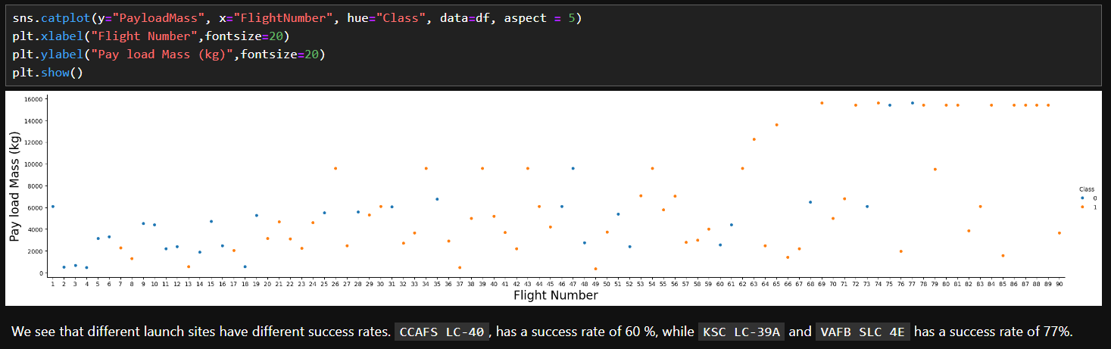
EDA with Data Visualization 1
https://github.com/Matt-Cust/IBM-DS0720EN-Capstone-project/blob/main/L5-%20jupyter-labs-eda-dataviz.ipynb.jupyterlite.ipynb
Summarize what charts were plotted and why you used those charts
Graphs from Jupyter labs in night mode

Slide 14
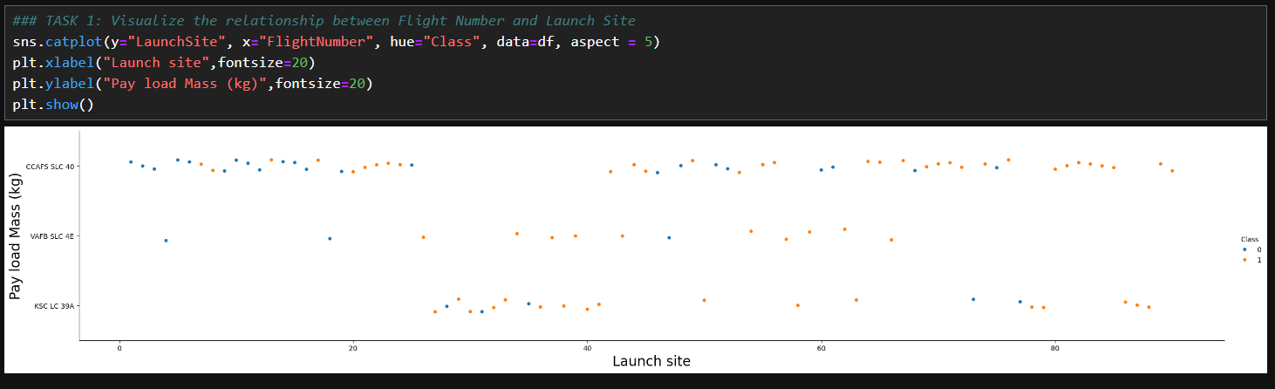
EDA with Data Visualization 2

Slide 15
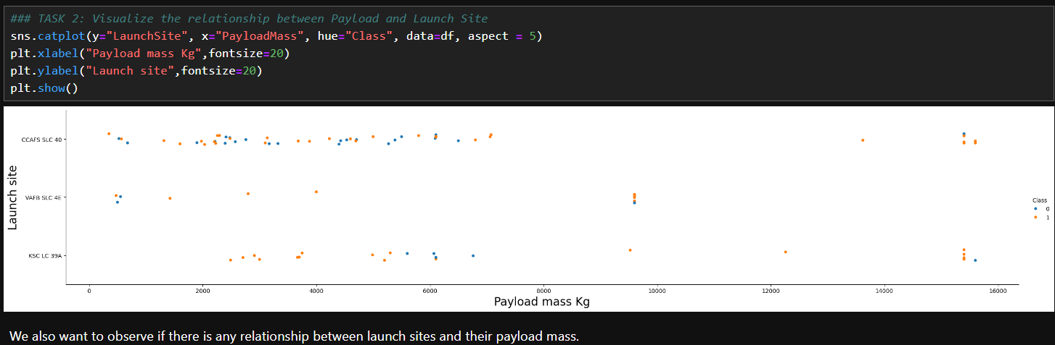
EDA with Data Visualization 3

Slide 16
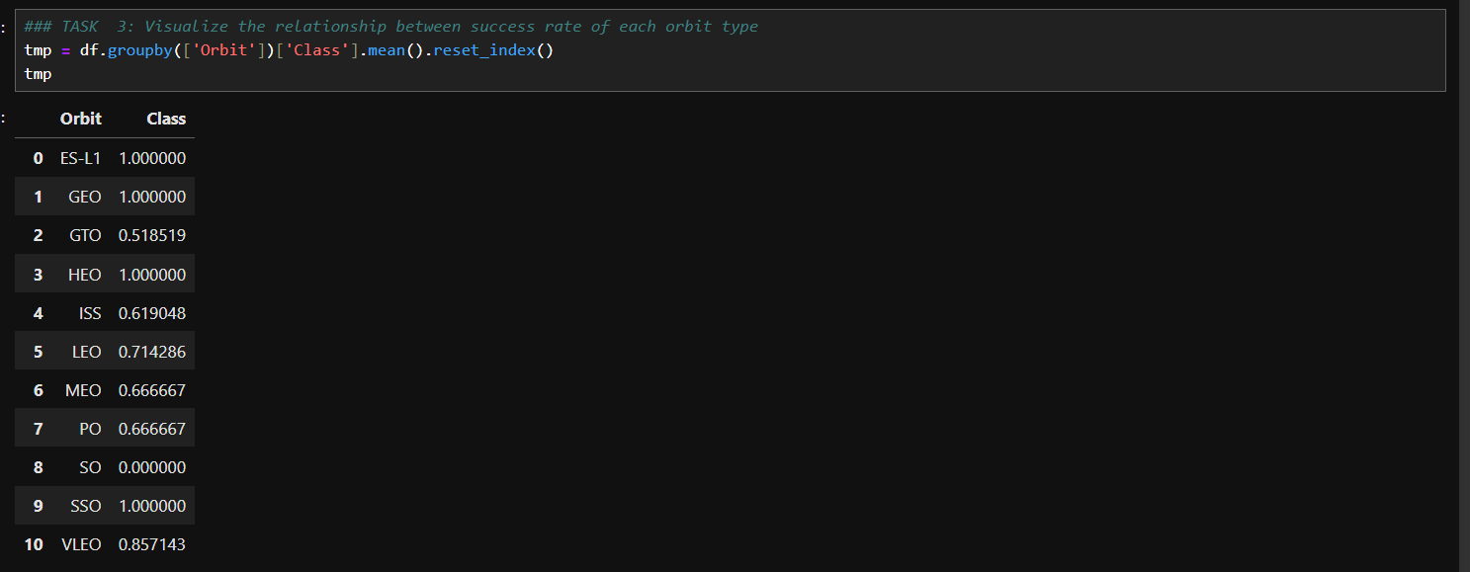
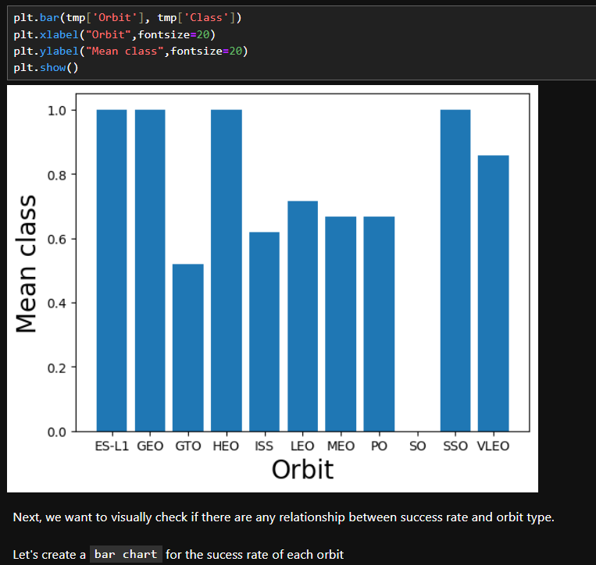
EDA with Data Visualization 4

Slide 17
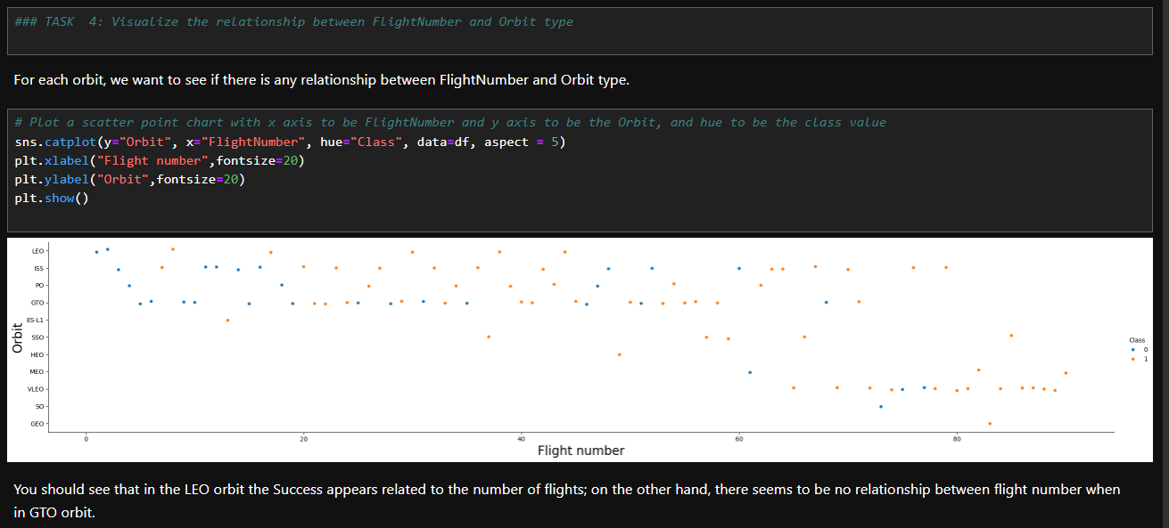
EDA with Data Visualization 5

Slide 18
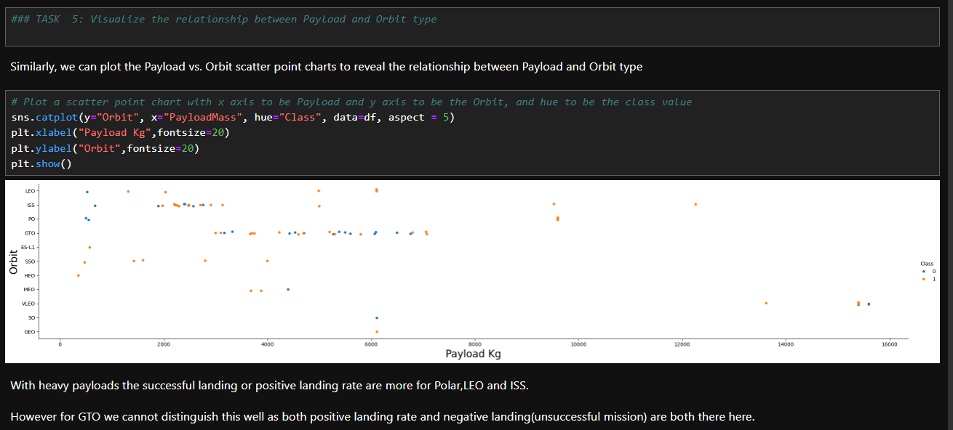
EDA with Data Visualization 6

Slide 19
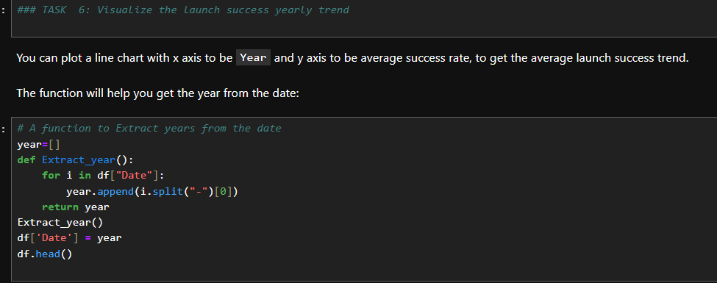
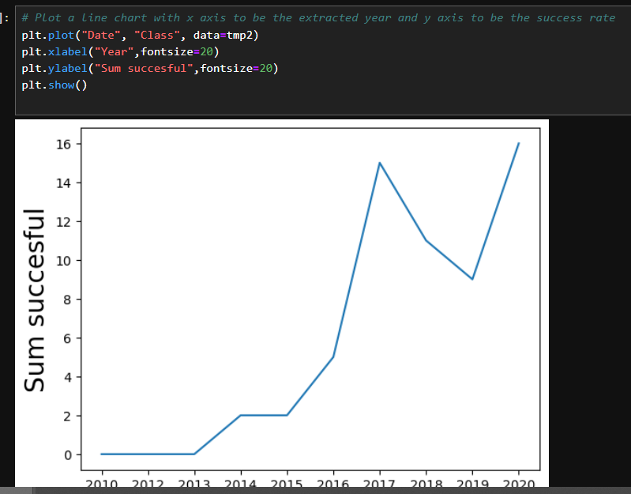
EDA with Data Visualization 7

Slide 20
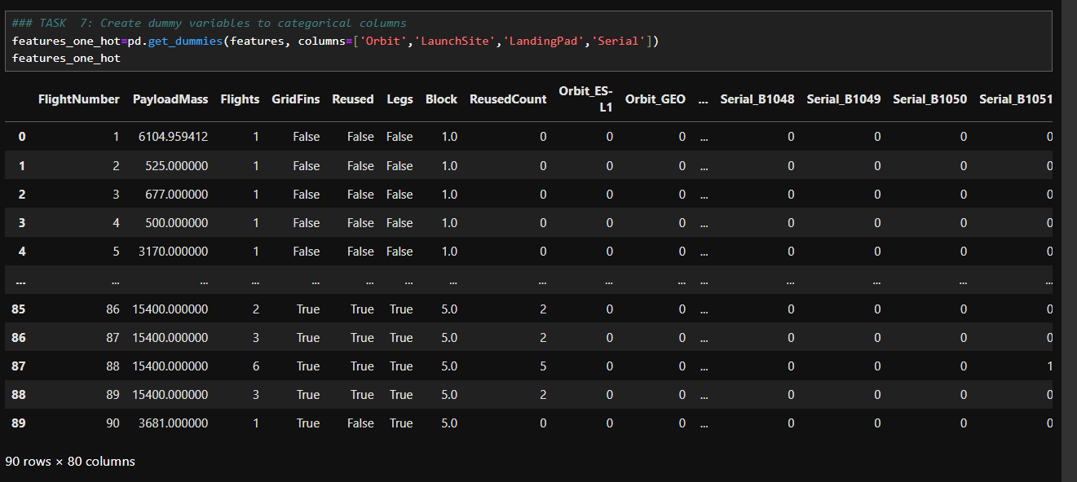
EDA with Data Visualization 8

Slide 21
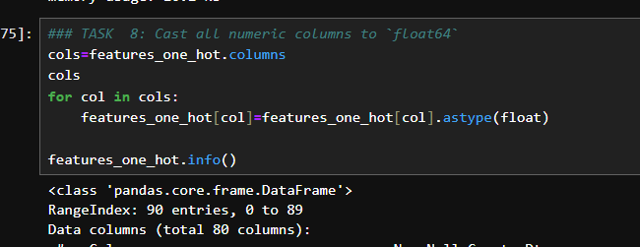
EDA with Data Visualization 9

Slide 22
EDA with SQL
https://github.com/Matt-Cust/IBM-DS0720EN-Capstone-project/blob/main/L4-%20jupyter-labs-eda-sql-edx_sqllite%20(1).ipynb
Task 1 - Display the names of the unique launch sites in the space mission
%sql select min(payload_mass__kg_) from SPACEXTBL;
%sql SELECT * from SPACEXTABLE LIMIT 20;
%sql SELECT avg(PAYLOAD_MASS__KG_) as Average_Payload_Mass from SPACEXTABLE;
%sql select count("Mission_Outcome") as MISSION_OUTCOME_COUNT,Launch_Site from SPACEXTBL group by "Launch_Site";
%sql SELECT distinct(LAUNCH_SITE) FROM SPACEXTABLE;
Task 2 - Display 5 records where launch sites begin with the string 'KSC’
%sql SELECT * FROM SPACEXTABLE WHERE LAUNCH_SITE LIKE 'KSC%' LIMIT 5;

Slide 23
EDA with SQL
Task 3 - Display the total payload mass carried by boosters launched by NASA (CRS)
%sql SELECT sum(PAYLOAD_MASS__KG_) FROM SPACEXTABLE WHERE "Customer" IS 'NASA (CRS)’;
Task 4- Display average payload mass carried by booster version F9 v1.1
%sql SELECT AVG(PAYLOAD_MASS__KG_) FROM SPACEXTABLE WHERE "Booster_Version" IS 'F9 v1.1’;
Task 5 - List the date where the succesful landing outcome in drone ship was achieved
%sql SELECT MIN("Date") FROM SPACEXTABLE WHERE "Landing_Outcome" IS 'Success (drone ship)’;
Task 6 - List the names of the boosters which have success in ground pad and have payload mass greater than 4000 but less than 6000
%sql SELECT ("Booster_Version") FROM SPACEXTABLE WHERE "Landing_Outcome" IS 'Success (ground pad)' AND "PAYLOAD_MASS__KG_" BETWEEN 4000 and 6000;

Slide 24
EDA with SQL
Task 7 - List the total number of successful and failure mission outcomes
%sql SELECT "MISSION_OUTCOME", COUNT(*) as "total_number" FROM SPACEXTABLE GROUP BY "MISSION_OUTCOME";
Task 8 – List the names of the booster_versions which have carried the maximum payload mass. Use a subquery
%sql SELECT "BOOSTER_VERSION" FROM SPACEXTABLE WHERE "PAYLOAD_MASS__KG_" = (SELECT MAX("PAYLOAD_MASS__KG_") FROM SPACEXTBL);
Task 9 - List the records which will display the month names, succesful landing_outcomes in ground pad ,booster versions, launch_site for the months in year 2017
%sql SELECT substr("Date",6,2) as month, "Date","Booster_Version", "Launch_Site ", "Landing_Outcome" FROM SPACEXTABLE where "Landing_Outcome" = 'Success (ground pad)' and substr("Date",0,5)='2017’;
Task 10 - Rank the count of landing outcomes (such as Failure (drone ship) or Success (ground pad)) between the date 2010-06-04 and 2017-03-20, in descending order
%sql SELECT "Landing_Outcome", COUNT("count_outcomes") FROM SPACEXTABLE WHERE "Date" BETWEEN '2010-06-04' AND '2017-03-20' GROUP BY "Landing _Outcome" ORDER BY "count_outcomes" DESC;

Slide 25
Build an Interactive Map with Folium
Summarize what map objects such as markers, circles, lines, etc. you created and added to a folium map
Folium.Circle
Folium.Marker
MarkerCluster
Icons
Folium.PolyLine
Explain why you added those objects
These were added because I was told to. But I think the point was to show the locations of the launch sites and counts of launches, and the count of Class’s from each site, and then to show location of nearby useful amenities.
Add the GitHub URL of your completed interactive map with Folium map, as an external reference and peer-review purpose
https://github.com/Matt-Cust/IBM-DS0720EN-Capstone-project/blob/main/L6-%20lab_jupyter_launch_site_location.jupyterlite.ipynb

Slide 26
Build a Dashboard with Plotly Dash
Summarize what plots/graphs and interactions you have added to a dashboard
A drop down menu to select launch site
A pie chart dependent upon the drop down showing Success count for each lunch site or total success/failure for the selected launch site.
A slider to select payload range
A scatter plot dependent upon the slider showing success or failure for different booster versions.
Explain why you added those plots and interactions
Again because I was told to. However the answer you're hopefully looking for is to see which launch sites had the highest success Vs Failure rates, and to investigate how booster version and payload mass impacted success rate.
Add the GitHub URL of your completed Plotly Dash lab, as an external reference and peer-review purpose
https://github.com/Matt-Cust/IBM-DS0720EN-Capstone-project/blob/main/L7-%20SpaceXDash.ipynb

Slide 27
Predictive Analysis (Classification)
Summarize how you built, evaluated, improved, and found the best performing classification model
You need present your model development process using key phrases and flowchart
Flow chart on the next slide.
Add the GitHub URL of your completed predictive analysis lab, as an external reference and peer-review purpose
https://github.com/Matt-Cust/IBM-DS0720EN-Capstone-project/blob/main/L8-%20SpaceX_Machine_Learning_Prediction_Part_5.jupyterlite.ipynb

Slide 28
Predictive Analysis (Classification)
Data loaded into Python and split into 2 (Y and X) as arrays.
Data scaled using preprocessing.StandardScaler.
Test and train data subset generated using train_test_split.
Logistic regression, Support Vector Machine learning, Decision Tree, and K nearest neighbours machine learning models were all created and tested using multiple input parameters as provided in the lab.
For each method a variety of input parameters were tested using GridSearchCV to find optimal set.
Each method was assessd by score and a confusion matrix
Once all models had been optimised they were compared by looking at; F1_Score, Precision, Recall, Accuracy, and Area Under Curve (AUC) to determine best model.

Slide 29
Results
Exploratory data analysis results
Interactive analytics demo in screenshots
Predictive analysis results
I’m assuming this is some sort of intro page not requiring population as then next few slides seem to wan the results as listed above.

Slide 30

Section 2

Slide 31
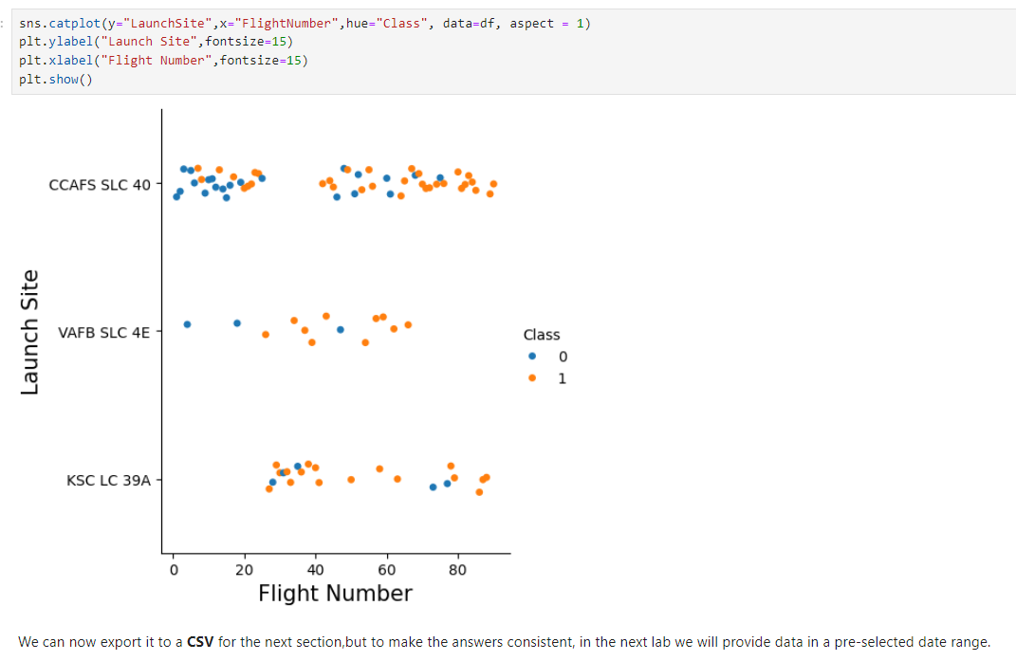
Flight Number vs. Launch Site
Show a scatter plot of Flight Number vs. Launch Site
Show the screenshot of the scatter plot with explanations
Y axis is jittered launch site, and X axis is launch number. Blue point is class 0 (failed lading), and Orange point is Class 1 (Successful landing)
In general higher success rate with higher flight number

Slide 32
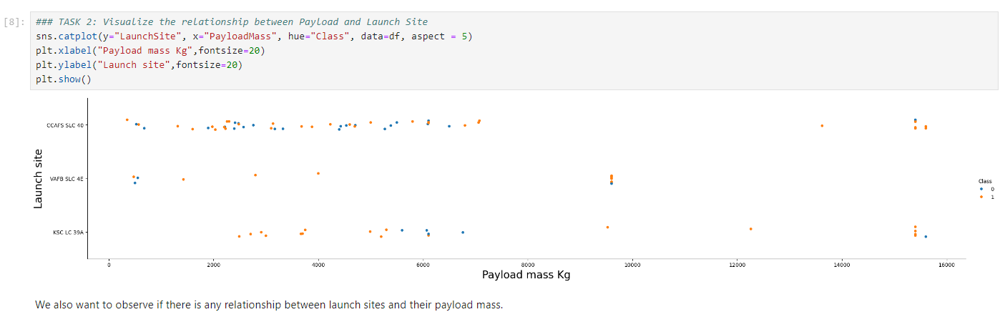
Payload vs. Launch Site
Show a scatter plot of Payload vs. Launch Site
Show the screenshot of the scatter plot with explanations
Y is jittered launch site, x is Payload mass, colour is Class, higher average success rate at higher mass, and no heavy launches from VAFB SLC 4E.

Slide 33
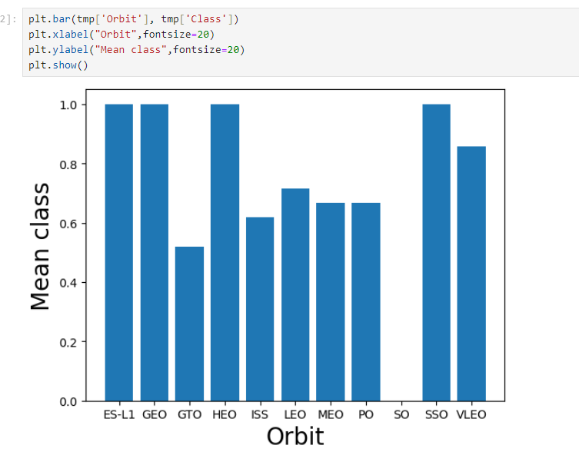
Success Rate vs. Orbit Type
Show a bar chart for the success rate of each orbit type
Show the screenshot of the scatter plot with explanations
X axis orbit type, Y axis averaged Class for each orbit type. ES-L1, GEO, HEO, SSO all 100% Calss 1 SO either no success or not attempted.

Slide 34
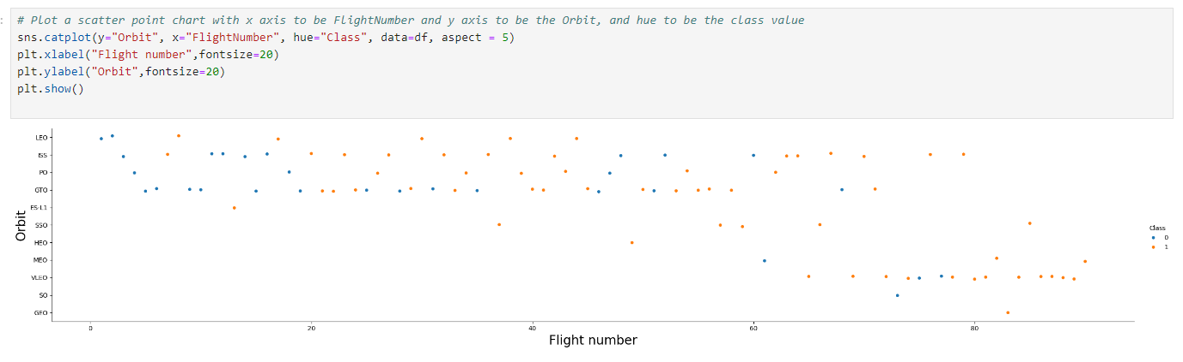
Flight Number vs. Orbit Type
Show a scatter point of Flight number vs. Orbit type
Show the screenshot of the scatter plot with explanations
X is flight number, y is orbit type, colour is class

Slide 35
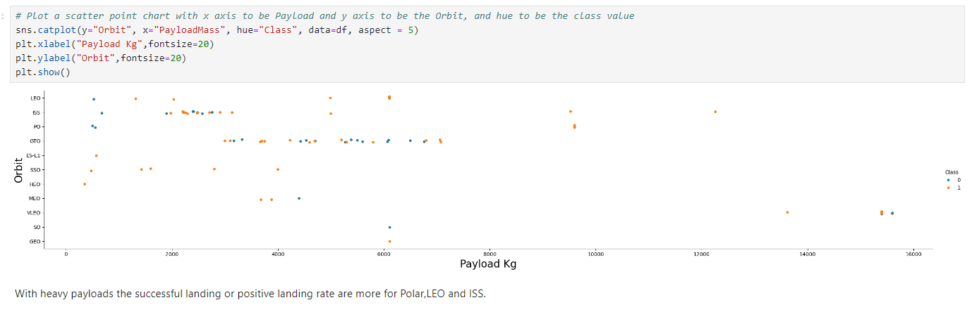
Payload vs. Orbit Type
Show a scatter point of payload vs. orbit type
Show the screenshot of the scatter plot with explanations
X payload mass Y Orbit type, colour Class. With heavy payloads the successful landing or positive landing rate are more for Polar, LEO and ISS.
However for GTO we cannot distinguish this well as both positive landing rate and negative landing(unsuccessful mission) are both there here.

Slide 36
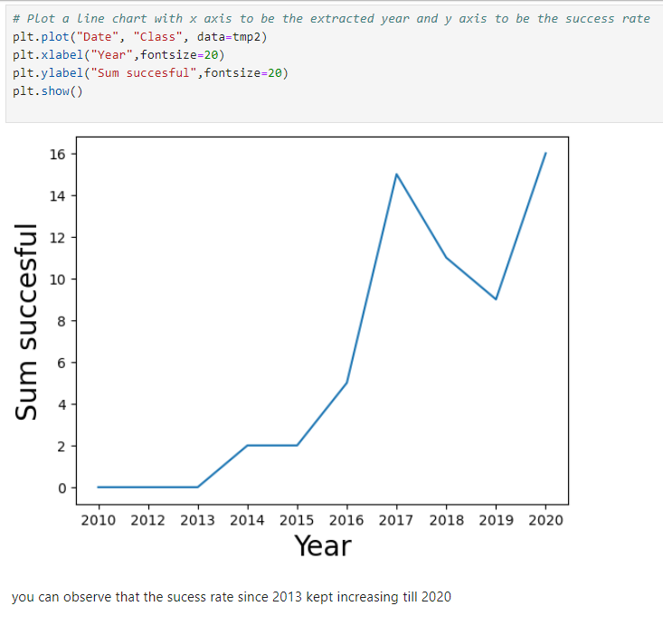
Launch Success Yearly Trend
Show a line chart of yearly average success rate
Show the screenshot of the scatter plot with explanations
X Years, Y Sum of successful Landings.
Total success count increases with time, apart from a reduction in 2018/2019

Slide 37
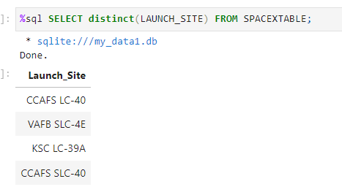
All Launch Site Names
Find the names of the unique launch sites
Present your query result with a short explanation here
Use distinct to get each unique value from LAUNCH_SITE variable in SPACEXTABLE.

Slide 38
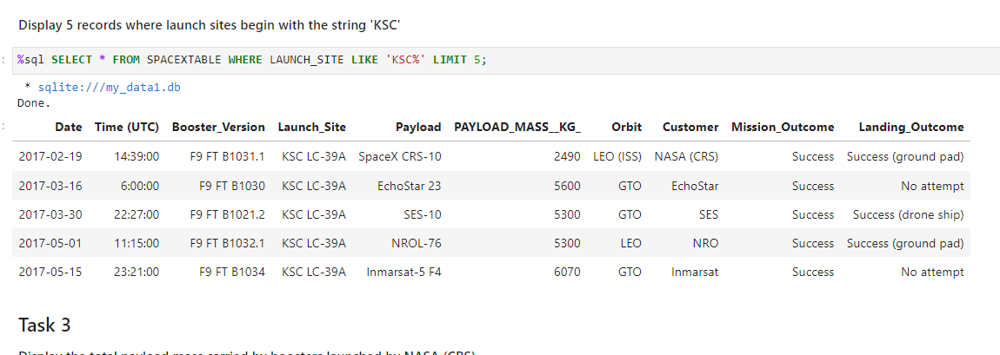
Launch Site Names Begin with 'KSC'
Find 5 records where launch sites’ names start with `KSC`
Present your query result with a short explanation here
Use WHERE and LIKE to find entries where Launsite contains “KSC”, use LIMIT to limit the number of results to 5.

Slide 39
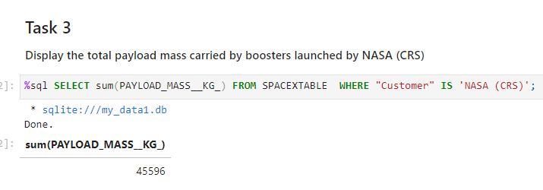
Total Payload Mass
Calculate the total payload carried by boosters from NASA
Present your query result with a short explanation here
Use WHERE and IS to limit Customer to be NASA and call SUM on PAYLOADMASS

Slide 40
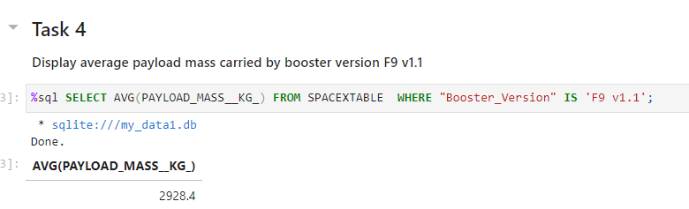
Average Payload Mass by F9 v1.1
Calculate the average payload mass carried by booster version F9 v1.1
Present your query result with a short explanation here
As before se WHERE and IS to select specific booster version and call AVG on PAYLOADMASS.

Slide 41
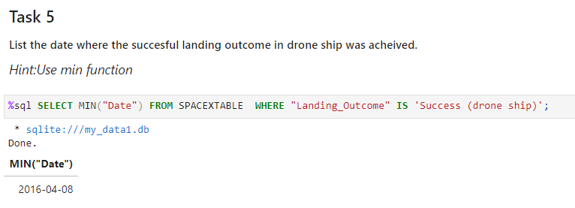
First Successful Ground Landing Date
Find the dates of the first successful landing outcome on drone ship.Present your query result with a short explanation here
Again WHERE and IS this time on Success., the call MIN on DATE to get first event.

Slide 42
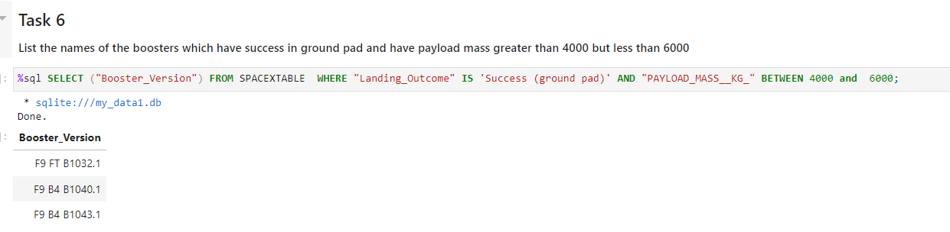
Successful Drone Ship Landing with Payload between 4000 and 6000
List the names of boosters which have successfully landed on drone ship and had payload mass greater than 4000 but less than 6000
Present your query result with a short explanation here
WHERE and IS again, but this time coupled with AND to add a second criteria and BETWEEN to set payload mass range.

Slide 43
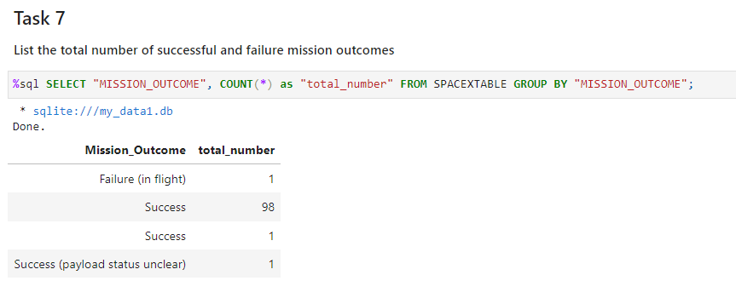
Total Number of Successful and Failure Mission Outcomes
Calculate the total number of successful and failure mission outcomes
Present your query result with a short explanation here
Use GROUPBY on MISSION OUTCOME and apply COUNT.

Slide 44
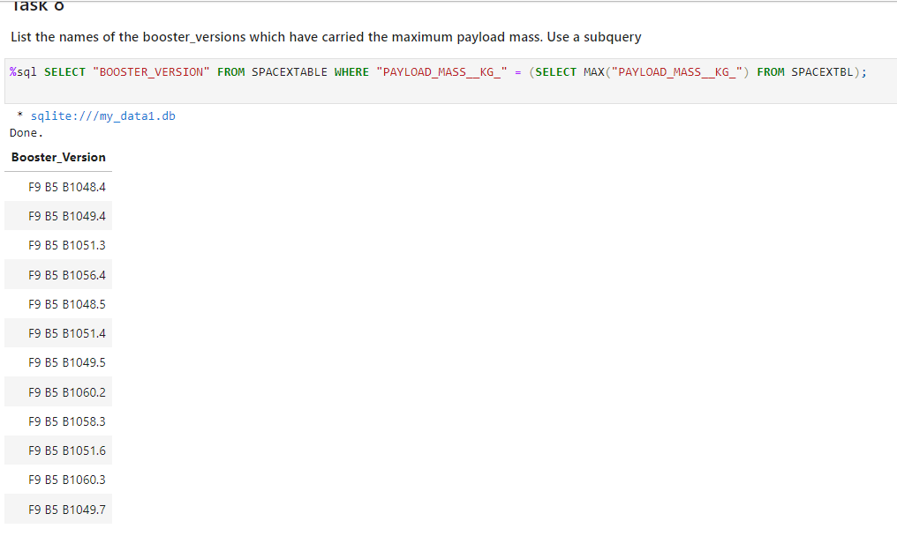
Boosters Carried Maximum Payload
List the names of the booster which have carried the maximum payload mass
Present your query result with a short explanation here
Subquery to determine max payload mass, then apply into a WHERE call. Use this to SELECT BOOSTER VERSION.

Slide 45
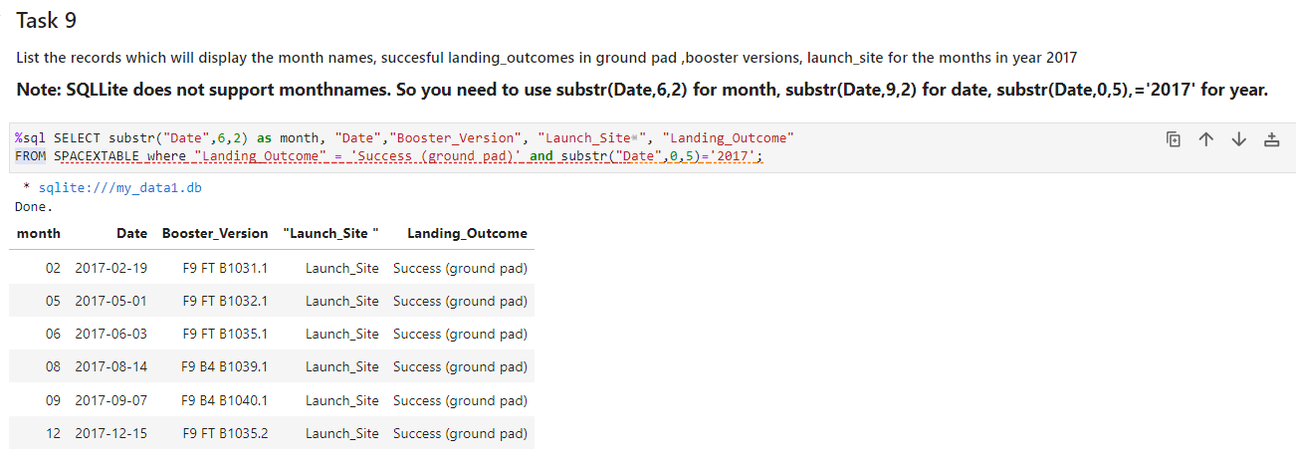
2015 Launch Records
List the records which will display the month names, succesful landing_outcomes in ground pad ,booster versions, launch_site for the months in year 2017
Present your query result with a short explanation here
WHERE LANDING is a success and the first 4 chars in DATE ==2017 create a new column called month which are the 6th and 7th chars in date.
SELECT to display:
DATE
GROUNDPAD
LAUNCH SITE
LANDING OUTCOME

Slide 46
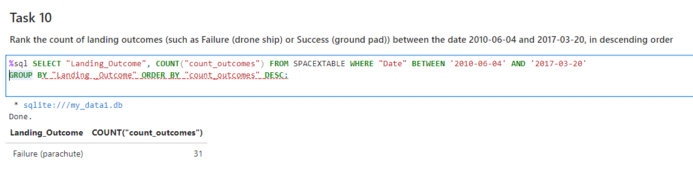
Rank Landing Outcomes Between 2010-06-04 and 2017-03-20
Rank the count of landing outcomes (such as Failure (drone ship) or Success (ground pad)) between the date 2010-06-04 and 2017-03-20, in descending order
Present your query result with a short explanation here
Use WHERE BETWEEN and AND to set criteria for selection, and then GROUPBY LANDINGOUTCOME, COUNT the outcomes and store in new column “Count_outcomes”, which should be ordered in DESC (Descending) order.
I couldn’t really get this one to work.

Slide 47

Section 3

Slide 48
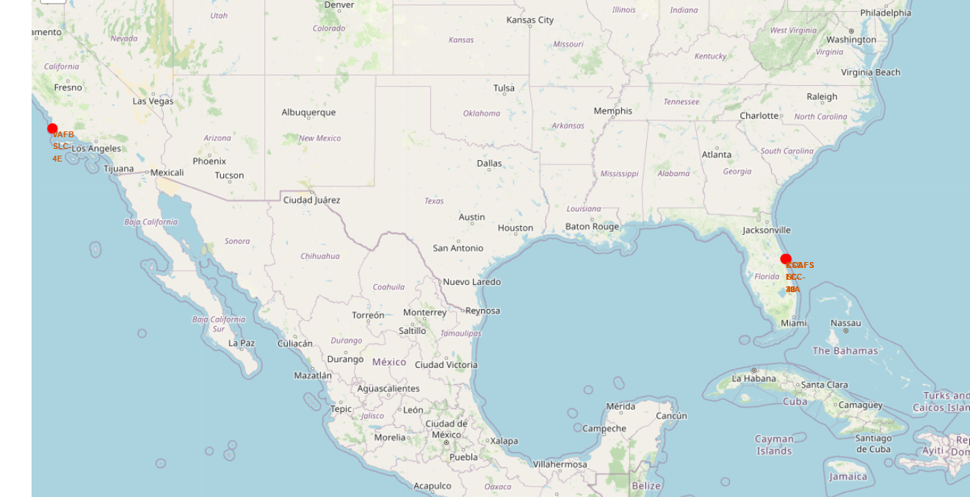
<Explore the generated folium map and make a proper screenshot to include all launch sites’ location markers on a global map
>
Replace <Folium map screenshot 1> title with an appropriate title
Explore the generated folium map and make a proper screenshot to include all launch sites’ location markers on a global map
Explain the important elements and findings on the screenshot
I added the red dots and text to show the launch sites, the rest of the map doesn’t matter.

Slide 49
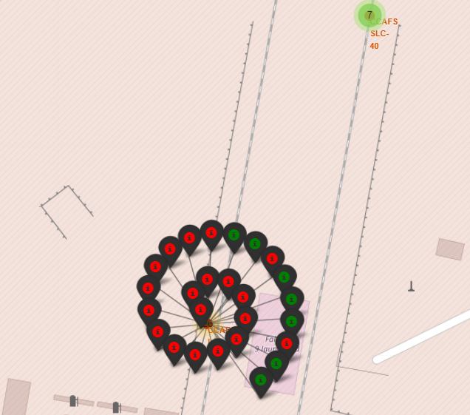
Explore the folium map and make a proper screenshot to show the color-labeled launch outcomes on the map
Replace <Folium map screenshot 2> title with an appropriate title
Explore the folium map and make a proper screenshot to show the color-labeled launch outcomes on the map
Explain the important elements and findings on the screenshot
Each icon represents an invidual launch the colour represent success or failure in booster return, the green 7 is another launch site.

Slide 50
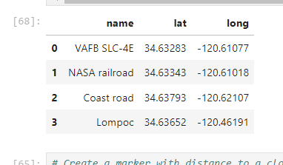
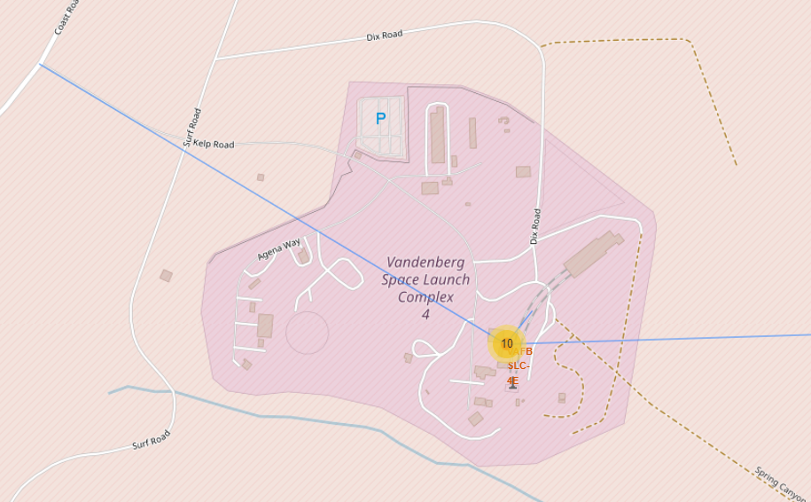
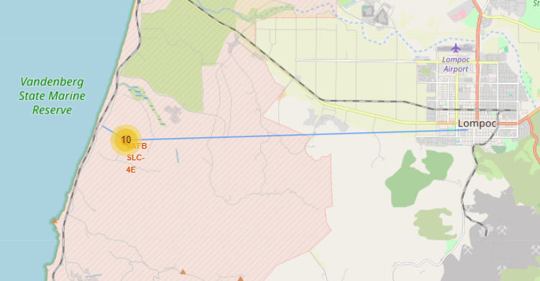
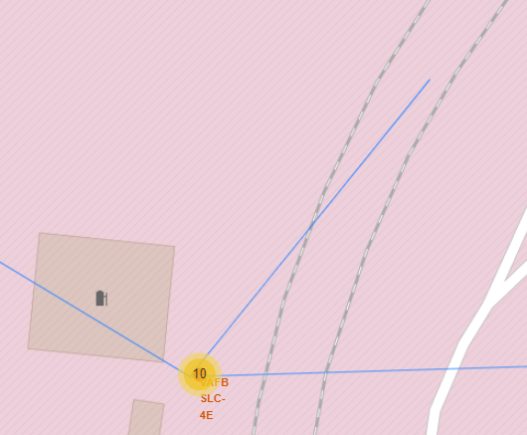
Explore the generated folium map and show the screenshot of a selected launch site to its proximities such as railway, highway, coastline, with distance calculated and displayed
Sorry had to do multiple zooms to show all POIs. Left graph is apparently a NASA train track, middle is a road/highway, and right is to the nearest city.
Sorry I couldn't get the distances to show on the graph, however I
Did calculate them (Table)

Slide 51

Section 4

Slide 52
< screenshot of launch success count for all sites, in a piechart >
I couldn’t get this to work in the Jupyter labs IDE, so I ran it in Jupyter Notebooks
This makes screenshots not as good unfortunately, and I prefer to use Dark/Night mode so background will be in black.
Apologies for any inconvenience going forwards.

Slide 53
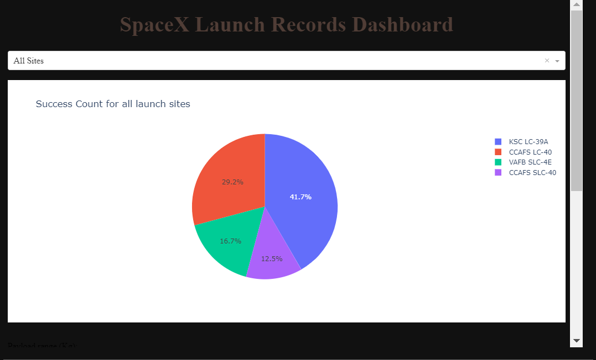
< screenshot of launch success count for all sites, in a piechart >
Replace <Dashboard screenshot 1> title with an appropriate title
Show the screenshot of launch success count for all sites, in a piechart
Explain the important elements and findings on the screenshot
Highest success count is KSC LC-39A with lowest being CCAFS SLC-40

Slide 54
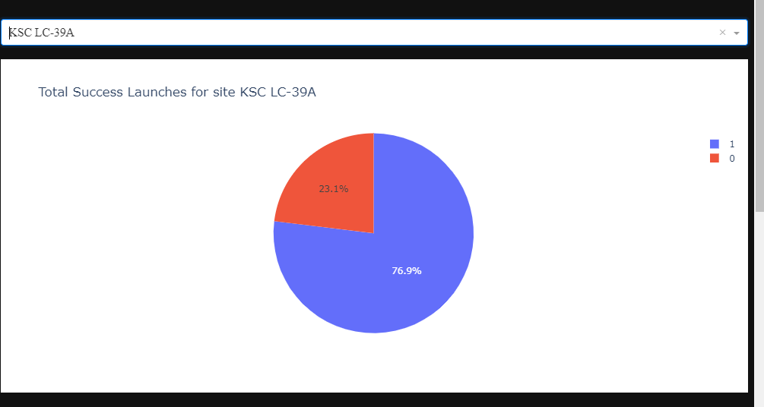
< screenshot of the piechart for the launch site with highest launch success ratio >
Replace <Dashboard screenshot 2> title with an appropriate title
Show the screenshot of the piechart for the launch site with highest launch success ratio
Explain the important elements and findings on the screenshot
KSC-LC39A has highest count and highest
success rate at ~77%

Slide 55
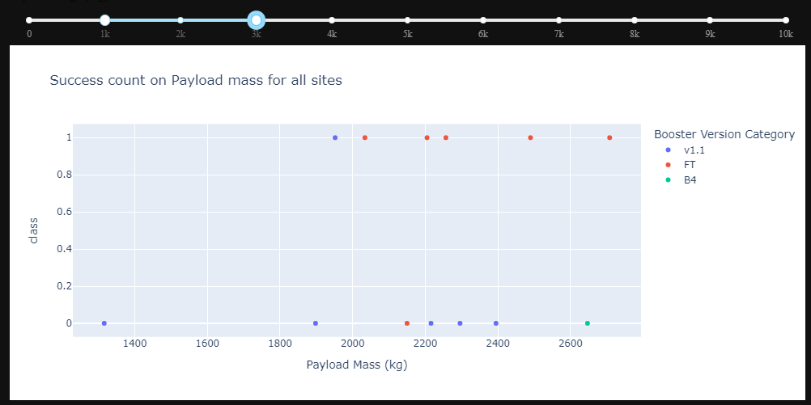
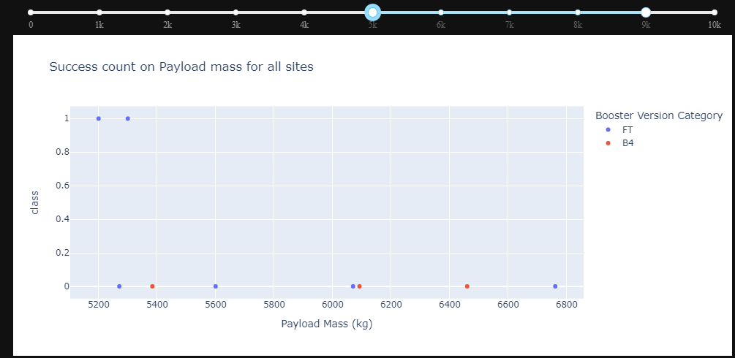
< screenshots of Payload vs. Launch Outcome scatter plot for all sites, with different payload selected in the range slider >
Replace <Dashboard screenshot 3> title with an appropriate title
Show screenshots of Payload vs. Launch Outcome scatter plot for all sites, with different payload selected in the range slider
Explain the important elements and findings on the screenshot, such as which payload range or booster version have the largest success rate, etc.
Left Range 1K-3K FT has highest success rate, Right Range 5K to 9K only FT has any successful landings.

Slide 56

Section 5

Slide 57
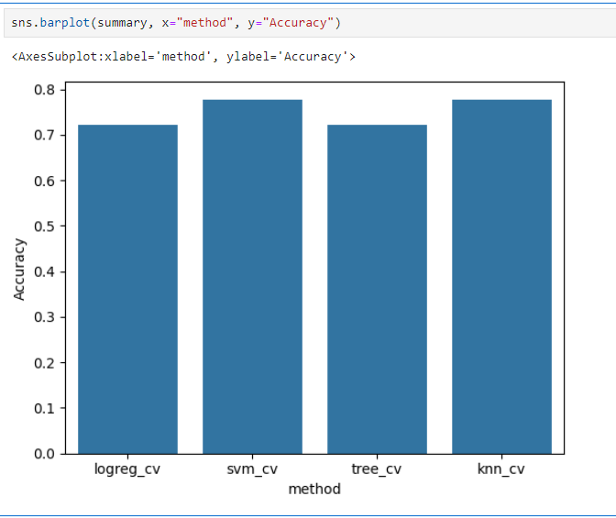
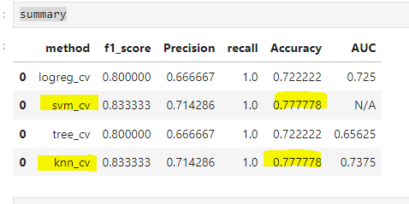
Classification Accuracy
Visualize the built model accuracy for all built classification models, in a bar chart
Find which model has the highest classification accuracy
SVM and KNN

Slide 58
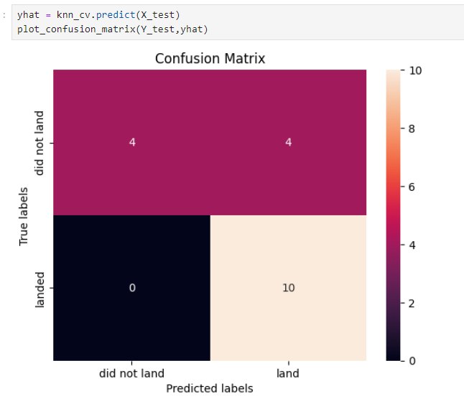
Confusion Matrix
Show the confusion matrix of the best performing model with an explanation
0x FP and 10xTP
4x each of TN and FN
Overall pretty much the same as the other confusion matrices the only reason I have declared this better than any other is because I like KNN.
Seriously svm and decision tree had exactly the same matrix's, only logistic had a different one and only 1 value.
But out of 18 tests only 4 were predicted incorrectly.

Slide 59
Conclusions
Primary conclusion- It is possible to use ML techniques to make semi accurate predictions about the likelihood of successful landing of the stage 1 booster post launch
Several factors including Launch site, launch number, booster version, payload mass, and intended orbit type can be employed as strong predictors.
While overall it’s still better than flipping a coin it is not something that I Would put my money on.
I bet you didn’t find all of my where’s Walleys (waldo for Americans)!

Slide 60
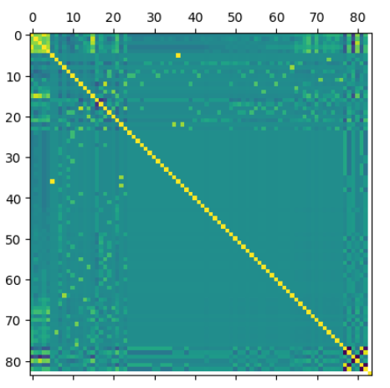
Appendix
Include any relevant assets like Python code snippets, SQL queries, charts, Notebook outputs, or data sets that you may have created during this project
x= pd.DataFrame(X) // y= pd.DataFrame(Y, columns=['Class’]) // z=pd.concat([x,y])// z.corr()
import matplotlib.pyplot as plt // plt.matshow(z.corr()) // plt.show()
Handy for seeing which if any factor is a major contributor
Note class is far right or bottom row/column

Slide 61
 | PayloadMass | Flights | Block | ReusedCount | Orbit_ES-L1 | Orbit_GEO | Orbit_GTO | Orbit_HEO | Orbit_ISS | ... | Serial_B1059 | Serial_B1060 | Serial_B1062 | GridFins_False | GridFins_True | Reused_False | Reused_True | Legs_False | Legs_True | Class
FlightNumber
FlightNumber | 1.00 | 0.60 | 0.65 | 0.93 | 0.74 | -0.13 | 0.15 | -0.26 | 0.01 | -0.13 | ... | 0.27 | 0.29 | 0.18 | -0.44 | 0.44 | -0.635844 | 0.635844 | -0.373619 | 0.373619 | NaN
PayloadMass | 0.60 | 1.00 | 0.67 | 0.52 | 0.61 | -0.13 | 0.00 | -0.15 | -0.13 | -0.33 | ... | -0.01 | 0.22 | -0.06 | -0.26 | 0.26 | -0.468393 | 0.468393 | -0.192318 | 0.192318 | NaN
Flights | 0.65 | 0.67 | 1.00 | 0.52 | 0.68 | -0.07 | 0.02 | -0.21 | -0.07 | -0.25 | ... | 0.13 | 0.03 | -0.07 | -0.19 | 0.19 | -0.782631 | 0.782631 | -0.157727 | 0.157727 | NaN
Block | 0.93 | 0.52 | 0.52 | 1.00 | 0.74 | -0.17 | 0.10 | -0.19 | 0.03 | -0.12 | ... | 0.20 | 0.18 | 0.10 | -0.44 | 0.44 | -0.548036 | 0.548036 | -0.368994 | 0.368994 | NaN
ReusedCount | 0.74 | 0.61 | 0.68 | 0.74 | 1.00 | -0.10 | 0.02 | -0.27 | -0.04 | -0.12 | ... | 0.17 | 0.04 | -0.10 | -0.41 | 0.41 | -0.594109 | 0.594109 | -0.375496 | 0.375496 | NaN
... | ... | ... | ... | ... | ... | ... | ... | ... | ... | ... | ... | ... | ... | ... | ... | ... | ... | ... | ... | ... | ...
Reused_False | -0.64 | -0.47 | -0.78 | -0.55 | -0.59 | 0.09 | -0.13 | 0.10 | 0.09 | 0.19 | ... | -0.15 | -0.10 | 0.09 | 0.23 | -0.23 | 1 | -1 | 0.155552 | -0.155552 | NaN
Reused_True | 0.64 | 0.47 | 0.78 | 0.55 | 0.59 | -0.09 | 0.13 | -0.10 | -0.09 | -0.19 | ... | 0.15 | 0.10 | -0.09 | -0.23 | 0.23 | -1 | 1 | -0.155552 | 0.155552 | NaN
Legs_False | -0.37 | -0.19 | -0.16 | -0.37 | -0.38 | -0.05 | -0.05 | 0.26 | -0.05 | -0.09 | ... | -0.11 | -0.10 | -0.05 | 0.90 | -0.90 | 0.155552 | -0.155552 | 1 | -1 | NaN
Legs_True | 0.37 | 0.19 | 0.16 | 0.37 | 0.38 | 0.05 | 0.05 | -0.26 | 0.05 | 0.09 | ... | 0.11 | 0.10 | 0.05 | -0.90 | 0.90 | -0.155552 | 0.155552 | -1 | 1 | NaN
Class | NaN | NaN | NaN | NaN | NaN | NaN | NaN | NaN | NaN | NaN | ... | NaN | NaN | NaN | NaN | NaN | NaN | NaN | NaN | NaN | 1
Appendix
Include any relevant assets like Python code snippets, SQL queries, charts, Notebook outputs, or data sets that you may have created during this project
x= pd.DataFrame(X) // y= pd.DataFrame(Y, columns=['Class’]) // z=pd.concat([x,y])// z.corr()

Slide 62


